Slide 1
Data Ingestion Considerations
Pravin Y Pawar
Adapted from
Fundamentals of Data Engineering
By Joe Reis and Matt Housley

Slide 2
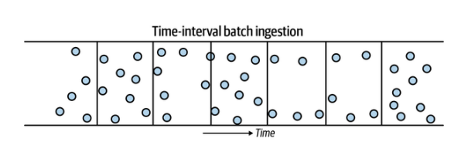
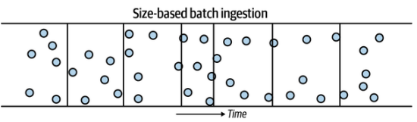
Batch Ingestion
Batch ingestion - processing data in bulk, is often a convenient way to ingest data
data is ingested by taking a subset of data from a source system, based either on a time
interval or the size of accumulated data
Time-interval batch ingestion
widespread in traditional business ETL for data warehousing
often used to process data once a day, overnight during off-hours, to provide daily reporting,
but other frequencies can also be used
Size-based batch ingestion
quite common when data is moved from a streaming-based system into object storage
ultimately, must cut the data into discrete blocks for future processing in a data lake
can break data into objects based on various criteria, such as the size in bytes of the total
number of events
Commonly used batch ingestion patterns:
Snapshot or differential extraction
File-based export and ingestion
ETL versus ELT
Inserts, updates, and batch size
Data migration

Slide 3
Batch Ingestion Considerations
Snapshot or Differential Extraction
Must choose whether to capture full snapshots of a source system or differential (incremental) updates
With full snapshots, grab the entire current state of the source system on each update read
With the differential update pattern, can pull only the updates and changes since the last read from the source system
Differential updates are ideal for minimizing network traffic and target storage usage
Full snapshot reads remain extremely common because of their simplicity

Slide 4
Batch Ingestion Considerations(2)
File-Based Export and Ingestion
Data is quite often moved between databases and systems using files
Data is serialized into files in an exchangeable format, and these files are provided to an ingestion system
A push-based ingestion pattern
data export and preparation work is done on the source system side
File-based ingestion has several potential advantages over a direct database connection approach
often undesirable to allow direct access to backend systems for security reason
files can be provided to the target system in various ways
Common file-exchange methods are object storage, secure file transfer protocol (SFTP), electronic
data interchange (EDI), or secure copy (SCP)

Slide 5
Batch Ingestion Considerations(3)
ETL Versus ELT
Extremely common ingestion, storage, and transformation patterns encountered in batch workloads
Extract
Getting data from a source system
Can be pulling data, or can be push based
Extraction may also require reading metadata and schema changes
Load
Once data is extracted,
it can either be transformed (ETL) before loading it into a storage destination
or simply loaded into storage for future transformation (ELT)
should be mindful of the type of system you’re loading, the schema of the data, and the performance impact of loading

Slide 6
Batch Ingestion Considerations(4)
Inserts, Updates, and Batch Size
Batch-oriented systems often perform poorly when users attempt to perform many small-batch
operations rather than a smaller number of large operations!
common to insert one row at a time in a transactional database, this is a bad pattern for many
columnar databases
Running many small in-place update operations is an even bigger problem
causes the database to scan each existing column file to run the update
Need to understand the appropriate update patterns for the database or data store working with
Certain technologies are purpose-built for high insert rates
Apache Druid and Apache Pinot can handle high insert rates
SingleStore can manage hybrid workloads that combine OLAP and OLTP characteristics
BigQuery performs poorly on a high rate of vanilla SQL single-row inserts but extremely well if data is
fed in through its stream buffer

Slide 7
Batch Ingestion Considerations(5)
Data Migration
Migrating data to a new database or environment is not usually trivial, and data needs to be moved in bulk
moving data sizes that are hundreds of terabytes or much larger, often involving the migration of specific tables and moving entire databases and systems
As is often the case for data ingestion, schema management is a crucial consideration
No matter how closely the two databases resemble each other, subtle differences almost always exist in the way
they handle schema
generally easy to test ingestion of a sample of data and find schema issues before undertaking a complete table
migration
Most data systems perform best when data is moved in bulk rather than as individual rows or events
File or object storage is often an excellent intermediate stage for transferring data
Many tools are available to automate various types of data migrations
Especially for large and complex migrations, look at these options before doing this manually or writing own
migration solution

Slide 8
Message and Stream Ingestion Considerations
Schema Evolution and Late-Arriving Data
Schema Evolution
common when handling event data - fields may be added or removed, or value types might change
can have unintended impacts on data pipelines and destinations - potentially impact downstream capabilities
To alleviate issues
if event-processing framework has a schema registry, use it to version schema changes
A dead-letter queue can help investigate issues with events that are not properly handled
Low-fidelity route (and the most effective) is regularly communicating with upstream stakeholders about
potential schema changes and proactively addressing schema changes with the teams introducing these changes
instead of reacting to the receiving end of breaking changes
Late-Arriving Data
Event data might arrive late - common when ingesting data - because of latency issues
A group of events might occur around the same time frame (similar event times), but some might arrive later than
others (late ingestion times)
should be aware of late arriving data and the impact on downstream systems and uses
To handle late-arriving data, need to set a cutoff time for when late-arriving data will no longer be processed

Slide 9
Message and Stream Ingestion Considerations(2)
Ordering and Multiple Delivery, Replay, Message Size
Ordering and Multiple Delivery
Streaming platforms are generally built out of distributed systems, which can cause some complications
Specifically, messages may be delivered out of order and more than once (at-least-once delivery)
Replay
allows readers to request a range of messages from the history, allowing to rewind your event history to a
particular point in time
a key capability in many streaming ingestion platforms and is particularly useful when need to reingest and
reprocess data for a specific time range
For example,
RabbitMQ typically deletes messages after all subscribers consume them
Kafka, Kinesis, and Pub/Sub all support event retention and replay
Message Size
easily overlooked issue - must ensure that the streaming framework in question can handle the maximum
expected message size
Amazon Kinesis supports a maximum message size of 1 MB
Kafka defaults to this maximum size but can be configured for a maximum of 20 MB or more

Slide 10
Message and Stream Ingestion Considerations(3)
Time to Live
How long to preserve event record?
A key parameter is maximum message retention time, also known as the time to live (TTL)
usually a configuration set for how long want events to live before they are acknowledged and ingested
Any unacknowledged event that’s not ingested after its TTL expires automatically disappears
Helpful to reduce backpressure and unnecessary event volume in event-ingestion pipeline.
An extremely short TTL (milliseconds or seconds) might cause most messages to disappear before
processing
A very long TTL (several weeks or months) will create a backlog of many unprocessed messages, resulting in long
wait times
For example,
Google Cloud Pub/Sub supports retention periods of up to 7 days
Amazon Kinesis Data Streams retention can be turned up to 365 days
Kafka can be configured for indefinite retention, limited by available disk space

Slide 11
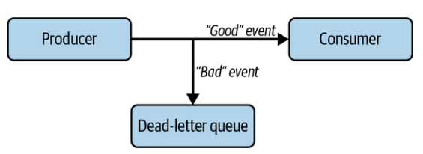
Message and Stream Ingestion Considerations(4)
Error Handling and Dead-Letter Queues
Sometimes events aren’t successfully ingested
Perhaps
an event is sent to a nonexistent topic or message queue
the message size may be too large
or the event has expired past its TTL
Dead-letter queue
Events that cannot be ingested need to be rerouted and stored in a separate location called a dead-letter queue
segregates problematic events from events that can be accepted by the consumer
If events are not rerouted to a dead-letter queue, these erroneous events risk blocking other messages from
being ingested
Can be used to
diagnose why event ingestions errors occur and solve data pipeline problems
might be able to reprocess some messages in the queue after fixing the underlying cause of errors

Slide 12
Message and Stream Ingestion Considerations(5)
Consumer Pull and Push
A consumer subscribing to a topic can get events in two ways: push and pull
Kafka and Kinesis support only pull subscriptions
Subscribers read messages from a topic and confirm when they have been processed
In addition to pull subscriptions, Pub/Sub and RabbitMQ support push subscriptions
allowing these services to write messages to a listener
Pull subscriptions are the default choice for most data engineering applications,
but may want to consider push capabilities for specialized applications
Pull-only message ingestion systems can still push if an extra layer is added to handle this

Slide 13
Thank You!
In our next session:

